Slide 1
Ensemble Learning
Techniques
Karthik Reddy Yeredla
Poola Sai Prapul Reddy

Slide 2
Basic Idea of Ensemble Learning:
Multiple models are combined to enhance predictive accuracy, reduce variance, and obtains a more generalized model.
Most Popular Techniques of Ensemble Learning are:
Bagging (Bootstrap Aggregation)
Boosting

Slide 3
Bagging: Leo Breiman(1994)
Step-1 (Bootstrap) :
Creating multiple subsets of the original dataset by randomly sampling with replacement.
Each subset, called a bootstrap sample, is used to train individual base models.
Step-2 (Aggregation):
In classification, the aggregation involves counting the predicted class labels from each base model in the ensemble. The final prediction is determined by selecting the class label that appears most frequently among the predictions.This approach is known as Majority Voting.
In regression, the aggregation step typically involves calculating the average or weighted average of the predicted values from each base model.
Bagging is typically used to reduce the variance of weak learners

Slide 4
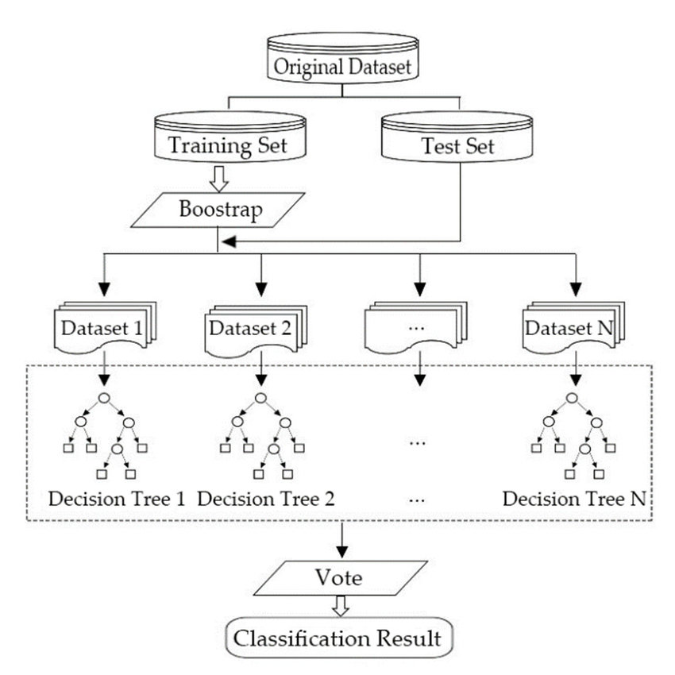
Applications:
Random Forest:

Slide 5
Why Bagging works?
Variance decreases in bagging due to the combination of two key principles
Diversity
When we create multiple bootstrap samples and train individual base models on each sample, we introduce diversity into the ensemble.
Each base model captures different patterns and errors. This diversity ensures that if one model makes a mistake, others are likely to make correct predictions.
Aggregation
By averaging or voting on the predictions, the ensemble prediction benefits from the collective wisdom of multiple models, producing a stable and accurate final prediction.
In essence, bagging's combination of diverse models and their aggregated predictions provides a counterbalance to the fluctuations and noise present in individual models

Slide 6
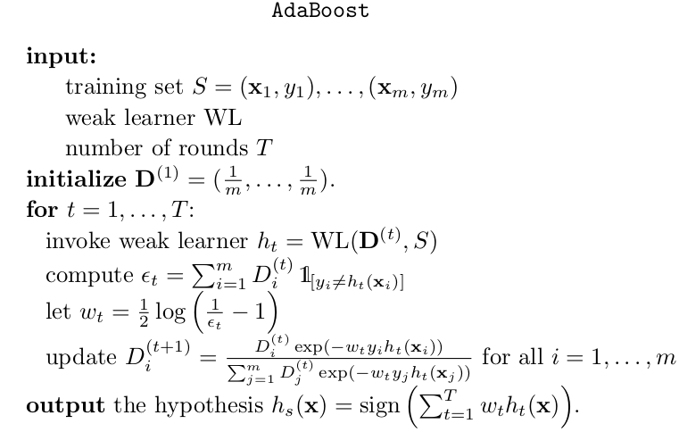
Boosting: Freund & Schapire(1996)
Idea : Train n weak learners sequentially and combine them to reduce model bias.

Slide 7
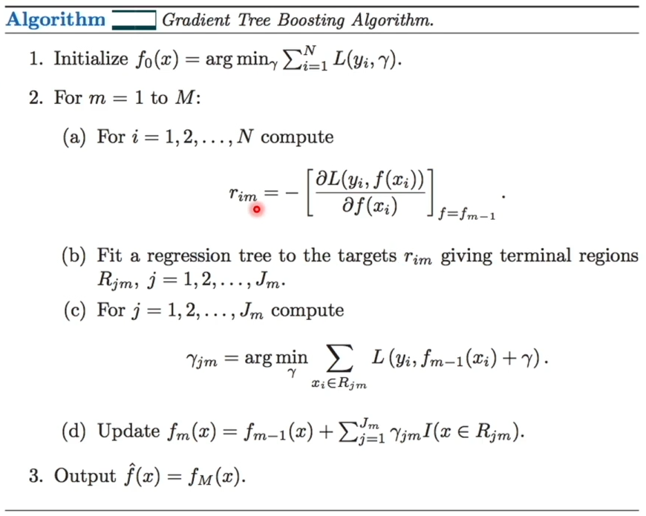
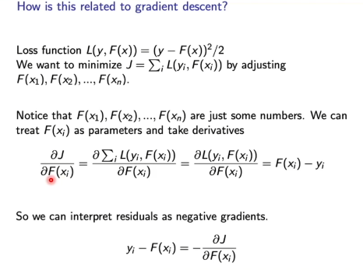
Gradient Boosting : Jerome H.Friedman(2001)

Slide 8
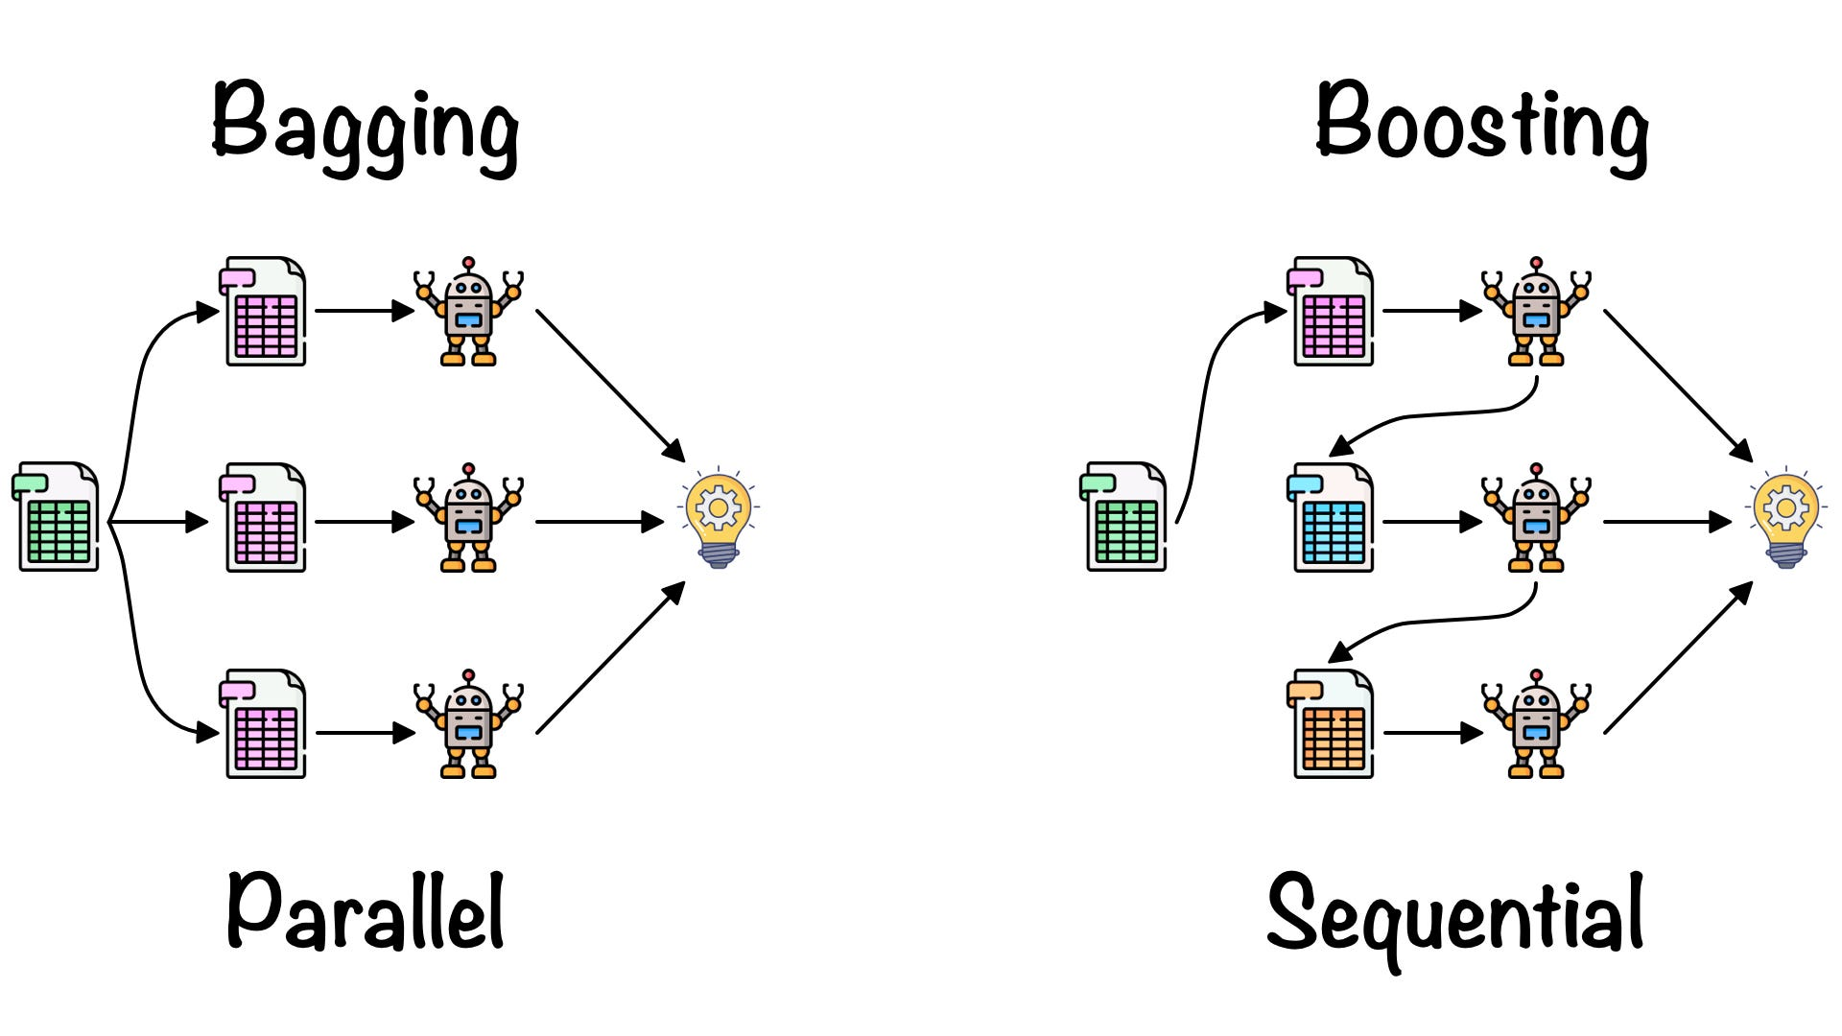

Slide 9
Evolution of Boosting Techniques:
Ada Boost - Freund & Schapire(1996)
Gradient Boosting - Jerome H.Friedman(2001)
XGBoost(Extreme Gradient Boosting) - Tianqi Chen(2014)
LightGBM - Microsoft Research (2017)
Catboost - Yandex (2017)

